Slide 1


Introduction to Urban Big Data and Machine Learning
CRP 3850/5850 Special Topics (2024 Summer)
Lecture 15 Machine Learning (I)
Wenzheng Li

Slide 2
Announcement
All assignments (1-4) should be submitted no later than Friday.
Friday Afternoon: 7-10 minutes presentation
Final poster due: Sunday night

Slide 3
OUTLINE
Introduction to Machine Learning
What is machine learning?
Machine learning types
Supervised Learning
Classification and Regression
Understand machine learning
Machine learning vs. statistics

Slide 4
1
What is Machine Learning

Slide 5
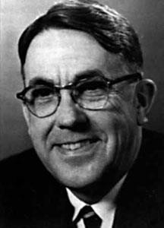
What is Machine Learning?
[Machine Learning is the] field of study that gives computers the ability to learn without being explicitly programmed.
---Arthur Samuel, 1959
Samuel, Arthur (1959). "Some Studies in Machine Learning Using the Game of Checkers". IBM Journal of
Research and Development. 3 (3): 210–229.
Notes:
was an American pioneer in the field of computer gaming and artificial intelligence.^{[2]} He popularized the term "machine learning" in 1959, and designed the world's first successful self-learning programs (let computers to play chess). His definition is:

Slide 6


What is Machine Learning?
Example 1: Spam Email Filter
Spam emails
Email System
Nonspam emails
Notes:
"Let's look at an example: a spam email filter. Imagine we want to create a system that filters spam emails.

Slide 7
What would you do to create such a system (machine)?
Task: filter spam emails
Spam emails
What are the conditions?
if conditions: it is a spam
else:
it is not a spam
bad words
ads (what are the ads)?
suspicious senders?
in title? In email body?
Not possible to write a rule to exhaust all cases!
Nonspam emails
Notes:
What would we do? We'd set conditions based on certain words, ads, suspicious senders, and other criteria. However, it's impossible to write a rule for every possible case."

Slide 8
What is Machine Learning?
Example 1: Spam Email Filter
Spam emails
Email System
Nonspam emails
Trained Machine

Slide 9

A spam filter based on machine learning
Spam
conditions:
bad words
ads (what are the ads)?
suspicious senders?
in title? In email body?
Spam
Good
Spam
Training
Good
Good
Good
Spam emails
Nonspam emails
Prediction
Notes:
Let computers to learn to summarize, and build the rules for us.

Slide 10






What is Machine Learning?
Example 2: Image Recognition
Task: whether there is a table in the image
10
Notes:
Let us take an example here. Image recognition. The task is for the computers to identify whether there is a table in the image.

Slide 11

A table detector based on machine learning
conditions:
Flat Surface?
Legs or Support?
Height Consistency?
Edges and Corners?
Shadows and Reflections?
Yes
Training
No
Yes
Yes
Yes
No
Prediction
11
Notes:
So we firstrly tell computers which one is a tbale>? Then computers can learn and summarize certain patterns (or common features) of the table.

Slide 12
What is Machine Learning?
We want a machine which can predict output accurately (most of time) based
on input data.
Input
Trained
Output
Spam
Spam
Spam
Good
Rules
Good
12
Notes:
We want a machine which can predict output accurately (most of time) base on input data. We do not specify the rules for computers, we ask the computers to learn by itself.

Slide 13
What is Machine Learning?
Training
Input Output
Rules
Spam
Spam
Spam
Good
Good
13
Notes:
And then summarize the rules for us.

Slide 14

What is Machine Learning?
Training
label
Training set
instance
Spam
?
Good
Spam
New instance
14
Notes:
Then applies the rule to the new instance to judge whether this instance is a spam or not.

Slide 15
Supervised Learning
Training
label
Training set
instance
Spam
?
Good
Spam
New instance
1. Supervised Learning: machine is trained with human supervision
with a “teacher”, (the training set is labeled)
15

Slide 16
Then, what is unsupervised learning?
1. Supervised Learning: machine is trained with human supervision
with a “teacher”, (the training set is labeled)
2. Unsupervised Learning: machine is trained without human supervision
without a “teacher”, (the training set is not labeled)
16

Slide 17
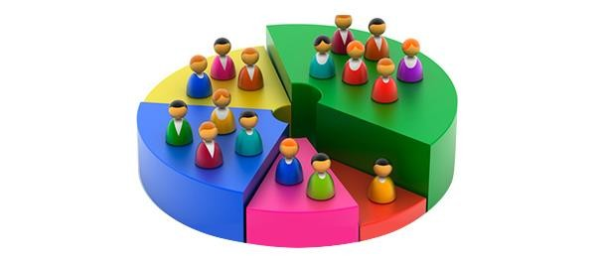
Unsupervised Learning
We want to classify customers into different types based on their attributes
17

Slide 18
Unsupervised Learning
We want to classify customers into different types based on their attributes
Clustering data based on identified patterns or structures.
Input
Trained
Output
We do not know the output!
18
Notes:
Unsupervised learning is a type of machine learning where the model is trained on data without labeled outcomes. The goal is to discover hidden patterns, structures, or features within the data.
One common task in unsupervised learning is clustering, where we group data points into clusters based on their similarities.
Input: The dataset containing customer attributes.
Trained Model: The model processes the input data to find patterns or clusters.
Output: The resulting clusters, which categorize customers into different groups based on identified patterns.

Slide 19
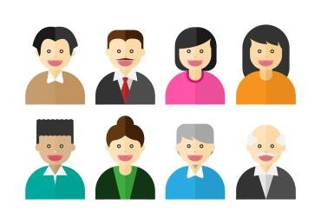

Unsupervised Learning
Training
Training set
instance
?
No label
New instance
2. Unsupervised Learning: machine is trained without human supervision
without a “teacher”, (the training set is not labeled)
19
Notes:
Of course, the results will not be labeled. We need to interpret them by ourself.
Unsupervised learning does not always require separate training and testing sets in the same way that supervised learning does.
(0) Generalization Check: Even without labels, it's important to ensure that the patterns or structures identified by the algorithm generalize well to new, unseen data. Splitting the data helps to validate that the model performs consistently across different subsets of data. Avoiding Overfitting
(1) Stability and Robustness: By applying the algorithm to different subsets (e.g., through cross-validation),
(2) Hyperparameter Tuning: Some unsupervised learning algorithms, such as K-Means, have hyperparameters (e.g., the number of clusters) that need to be set. By splitting the data, you can use a portion of the data to tune these hyperparameters and the rest to validate the results.
(3) Algorithm Comparison: When comparing different algorithms or variations of the same algorithm, using separate sets can help ensure that comparisons are fair and not overfitted to a single dataset.

Slide 20
Machine Learning Types
1. Supervised Learning: machine is trained with human supervision
with a “teacher”, (the training set is labeled)
2. Unsupervised Learning: machine is trained without human supervision
without a “teacher”, (the training set is not labeled)
Semisupervised Learning
Reinforcement Learning
20
Notes:
Techniques for Validation in Unsupervised Learning:
Cronbach's alpha: check the consistency between samples.
Comparison with Ground Truth
Bootstrap Method: Repeatedly sample from the dataset and apply clustering to each sample. Assess the variability of the clustering results.
Unsupervised learning does not always require separate training and testing sets in the same way that supervised learning does.
(0) Generalization Check: Even without labels, it's important to ensure that the patterns or structures identified by the algorithm generalize well to new, unseen data. Splitting the data helps to validate that the model performs consistently across different subsets of data. Avoiding Overfitting
(1) Stability and Robustness: By applying the algorithm to different subsets (e.g., through cross-validation),
(2) Hyperparameter Tuning: Some unsupervised learning algorithms, such as K-Means, have hyperparameters (e.g., the number of clusters) that need to be set. By splitting the data, you can use a portion of the data to tune these hyperparameters and the rest to validate the results.
(3) Algorithm Comparison: When comparing different algorithms or variations of the same algorithm, using separate sets can help ensure that comparisons are fair and not overfitted to a single dataset.
# Why unsupervised learning still wants training set:
(1)

Slide 21

Traditional Program
Input
Output
Rules
Input
Machine Learning
Rules
Output
5

Slide 22
2
Supervised Learning
22

Slide 23
Supervised Learning
Associating features with some label.
Two tasks :
Classification: labels as discrete categories
Spam email or not
With a table or not
Regression: labels as continuous quantities.
Housing price
categorical
Output
numeric
Input
Trained
25
Notes:
is a type of machine learning where the model is trained on a labeled dataset. In this context, "labeled" means that each training example is paired with an output label. The goal of supervised learning is to learn a mapping from inputs to outputs that can be used to make predictions on new, unseen data.

Slide 24



Understand Machine Learning
What do I mean if I want to build a machine learning model for my housing transaction dataset?
Input
Housing datasets with attributes
Trained
Output
Housing prices

Slide 25
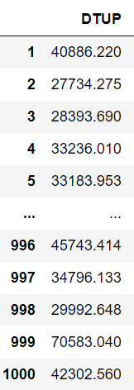
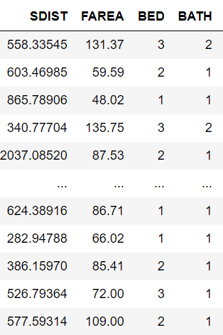
Understand Machine Learning
target
features
Output
Input
Features, also known as attributes or variables, are the individual measurable characteristics of the data that are used as input.
The target, also known as the label or dependent variable, is the outcome or value that the machine learning model is trying to predict.

Slide 26
Understand Machine Learning
SDIST
BATH
DTUP
FAREA
BED
How about a linear regression model?
o Linear regression is a type of machine learning model
𝑫𝑻𝑼𝑷 = 𝛽₀ + 𝛽₁𝑺𝑫𝑰𝑺𝑻 + 𝛽₂𝑭𝑨𝑹𝑬𝑨 + 𝛽₃𝑩𝑬𝑫 + 𝛽₄𝑩𝑨𝑻𝑯 + 𝜀

Slide 27
Supervised Learning
Two tasks :
Classification: output is categorical
Spam email or not
With a table or not
Logistic Regression is here!!!
o Regression: output is numeric
O Housing price
Linear Regression is here!!!
categorical
Output
numeric
Trained
Input
29

Slide 28
Machine Learning vs. Statistics
𝑫𝑻𝑼𝑷 = 𝛽₀ + 𝛽₁𝑺𝑫𝑰𝑺𝑻 + 𝛽₂𝑭𝑨𝑹𝑬𝑨 + 𝛽₃𝑩𝑬𝑫 + 𝛽₄𝑩𝑨𝑻𝑯 + 𝜀
Machine learning cares about prediction
field of predictive modeling
concerned with minimizing the prediction error or making the most accurate predictions
borrow algorithms from statistics for predication purposes
Statistics cares about estimation and inference
field of statistical modeling
understanding the relationship between variables
many models/algorithms have been borrowed by machine learning.
28

Slide 29
Machine Learning vs. Statistics
Statistics: hypothesis testing, model assumptions, explanation, and interpretation
In machine learning, different than in applied statistics, we are less interested in what these parameters are, and more in how well they can
Make predictions
Describe underlying structures or characteristics in the data

Slide 30
3
Machine Learning Algorithm

Slide 31
Machine Learning
Algorithm
Input
Machine Learning
Rules
Output
14

Slide 32
Algorithm
In mathematics and computer science, an algorithm is a finite sequence of well-defined, computer-implementable instructions, typically to solve a class of problems or to perform a computation. (Wikipedia)
32

Slide 33
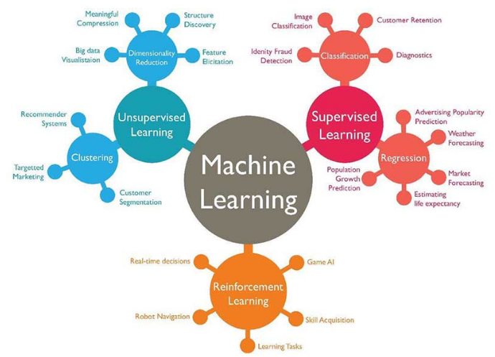
Machine Learning Algorithm
Supervised learning
Classification
K-nearest neighbors
logistic regression
Random forest
…
Regression
Linear regression
…
Unsupervised learning
Clustering
K-means clustering
…
Dimensionality Reduction
PCA and factor analysis
…
33

Slide 34
Algorithm Example: Linear Regression
Supervised learning
o Regression Problem
𝒚
𝒚 | 𝒙_{𝟏}
20000 | 800
60000 | 2000
14000 | 632
54000 | 1800
20000 | 750
20000 | 400
… | …
𝑦_{𝑖} = 𝛽₀ + 𝛽₁𝑥_{1𝑖} + 𝜀_{𝑖}
OLS: Ordinary Least Squares
𝒙_{𝟏}
minimize sum of squared errors

Slide 35
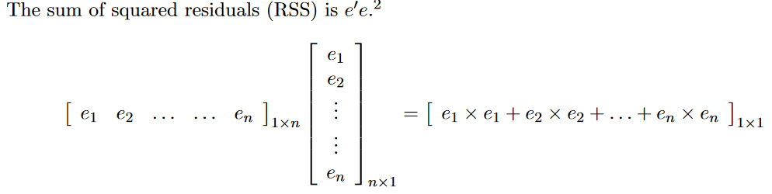


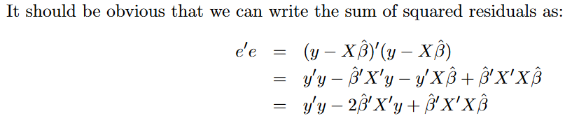


Algorithm Example: Linear Regression
We need to take the derivative of the above equation:
https://web.stanford.edu/~mrosenfe/soc_meth_proj3/matrix_OLS_NYU_notes.pdf

Slide 36
Algorithm Example: Classification
y = 0
y = 1
Supervised learning
Classification Problem
Binary Choice
𝒚
𝒙_{𝟏}
800
0
1
0
1
1
0
…
2000
632
1800
750
400
…
?
?
?
𝒙_{𝟏}

Slide 37
Algorithm Example: Logistic Regression
y = 0
y = 1
Supervised learning
o Classification Problem
Binary Choice
𝒚
𝒚 | 𝒙_{𝟏}
0 | 800
1 | 2000
0 | 632
1 | 1800
1 | 750
0 | 400
… | …
1
0.5
exp(𝛽₀ + 𝛽₁𝑥_{1𝑖})
𝑃(𝑦
𝑖
= 1|𝑥 ) =
?
?
?
1𝑖
1 + exp(𝛽 + 𝛽 𝑥 )
0 1 1𝑖
0
𝒙_{𝟏}
MLE: Maximum Likelihood Estimation
Notes:
sigmoid function. The output of the sigmoid function is a probability value between 0 and 1. This probability is used to classify the input into one of the two classes. For binary classification, a common threshold is 0.5, where values above 0.5 are classified as one class and values below 0.5 as the other class.

Slide 38
Algorithm Example: K-Nearest Neighbors
y = 0
y = 1
Supervised learning
Classification Problem
Binary Choice
?
?
?
𝒙_{𝟏}
𝒚
𝒙_{𝟏}
800
0
1
0
1
1
0
…
2000
632
1800
750
400
…
Notes:
the K-Nearest Neighbors (KNN) algorithm does not perform an explicit training phase like many other machine learning algorithms. Instead, KNN is often referred to as a "lazy learner" because it simply stores the training data and makes predictions by calculating distances to the known data points when a query is made.
The number of nearest neighbors (k) to consider when making a prediction. The choice of k affects the algorithm's performance:Small k: Can lead to a model that is sensitive to noise in the training data (overfitting).
Large k: Can lead to a model that is too generalized (underfitting).

Slide 39
Algorithm Example: K-Nearest Neighbors
y = 0
y = 1
Supervised learning
Classification Problem
Binary Choice
?
?
?
𝒙_{𝟏}
𝒚
𝒙_{𝟏}
800
1 Nearest Neighbor
0
1
0
1
1
0
…
2000
𝒙
632
𝟏
1800
750
400
…
Notes:
the K-Nearest Neighbors (KNN) algorithm does not perform an explicit training phase like many other machine learning algorithms. Instead, KNN is often referred to as a "lazy learner" because it simply stores the training data and makes predictions by calculating distances to the known data points when a query is made.
The number of nearest neighbors (k) to consider when making a prediction. The choice of k affects the algorithm's performance:Small k: Can lead to a model that is sensitive to noise in the training data (overfitting).
Large k: Can lead to a model that is too generalized (underfitting).

Slide 40
Algorithm Example: K-Nearest Neighbors
y = 0
y = 1
Supervised learning
Classification Problem
Binary Choice
?
?
?
𝒙_{𝟏}
𝒚
𝒙_{𝟏}
800
1 Nearest Neighbor
0
1
0
1
1
0
…
2000
𝒙
632
𝟏
1800
750
400
…
3 Nearest Neighbor
𝒙_{𝟏}
k Nearest Neighbor…
Notes:
the K-Nearest Neighbors (KNN) algorithm does not perform an explicit training phase like many other machine learning algorithms. Instead, KNN is often referred to as a "lazy learner" because it simply stores the training data and makes predictions by calculating distances to the known data points when a query is made.
The number of nearest neighbors (k) to consider when making a prediction. The choice of k affects the algorithm's performance:Small k: Can lead to a model that is sensitive to noise in the training data (overfitting).
Large k: Can lead to a model that is too generalized (underfitting).

Slide 41
Algorithm Example: K-Nearest Neighbors
Supervised learning
Classification Problem
Binary Choice
KNN is often referred to as a "lazy learner“
it simply stores the training data and makes predictions by calculating distances to the known data points
𝒚
𝒙_{𝟏}
800
The number of nearest neighbors (k) to consider when making a prediction
Small k: Can lead to a model that is sensitive to noise in the training data (overfitting).
Large k: Can lead to a model that is too generalized (underfitting).
0
1
0
1
1
0
…
2000
632
1800
750
400
…
Notes:
the K-Nearest Neighbors (KNN) algorithm does not perform an explicit training phase like many other machine learning algorithms. Instead, KNN is often referred to as a "lazy learner" because it simply stores the training data and makes predictions by calculating distances to the known data points when a query is made.
The number of nearest neighbors (k) to consider when making a prediction. The choice of k affects the algorithm's performance:Small k: Can lead to a model that is sensitive to noise in the training data (overfitting).
Large k: Can lead to a model that is too generalized (underfitting).

Slide 42
4
Machine Learning Steps
42

Slide 43
Machine Learning Steps
Gathering and loading data (what features to collect)
Exploring data (e.g., pandas and visualization)
Transforming data (e.g., string to numeric)
Splitting data for training and testing
Choosing and creating a model
Training
Testing (evaluating accuracy)
Tuning the model (hyperparameters)
Making predictions on new data
Data Preparation
43
Notes:
Most machine learning algorithms, especially those involving mathematical computations (like linear regression, logistic regression, and neural networks), require numerical input.
Label Encoding: Converts categorical labels into numerical values.
One-Hot Encoding: Converts categorical labels into numerical values.
Ordinal Encoding: Similar to label encoding but used for ordinal categories where there is an inherent order.

Slide 44
Transforming data (e.g., string to numeric)
Label Encoding: Converts categorical labels into numerical values.
["red", "green", "blue"] -> [0, 1, 2]
One-Hot Encoding: Converts categorical labels into numerical values.
["red", "green", "blue"] -> three dummy variables
Ordinal Encoding: Similar to label encoding but used for ordinal categories where there is an inherent order.
["low", "medium", "high"] -> [1, 2, 3]
Notes:
in certain scenarios, especially to avoid multicollinearity in linear regression models, you might use n−1n-1n−1 dummy variables instead. This approach is known as dummy variable trap avoidance.
Dummy Variable Trap
The dummy variable trap occurs when the dummy variables are highly correlated, meaning one dummy variable can be predicted from the others. This multicollinearity can cause problems in regression models, making it difficult to interpret the coefficients and potentially leading to numerical instability in the model estimation.

Slide 45
Training
target
features
Output
Input
Features, also known as attributes or variables, are the individual measurable characteristics of the data that are used as input.
The target, also known as the label or dependent variable, is the outcome or value that the machine learning model is trying to predict.
45
Notes:
The target, also known as the label or dependent variable, is the outcome or value that the machine learning model is trying to predict.

Slide 46
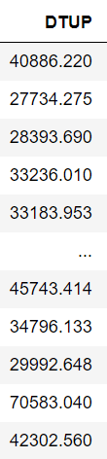
Splitting data for training and testing
Training set 75%
(80%)
Testing set 25%
(20%)
46

Slide 47
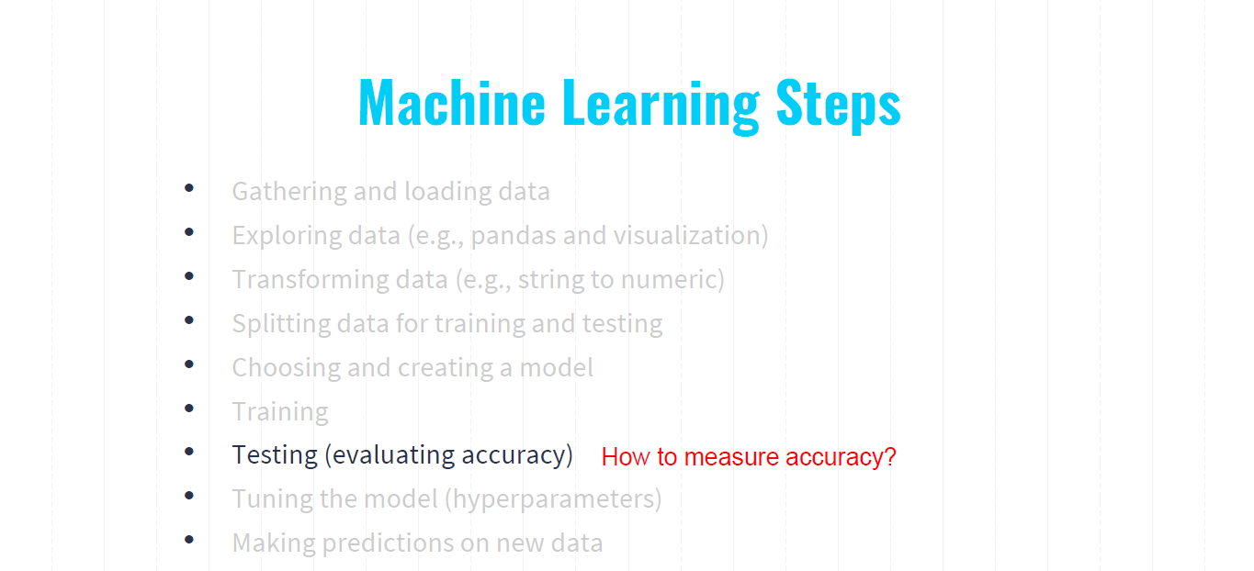
Machine Learning Steps
47

Slide 48
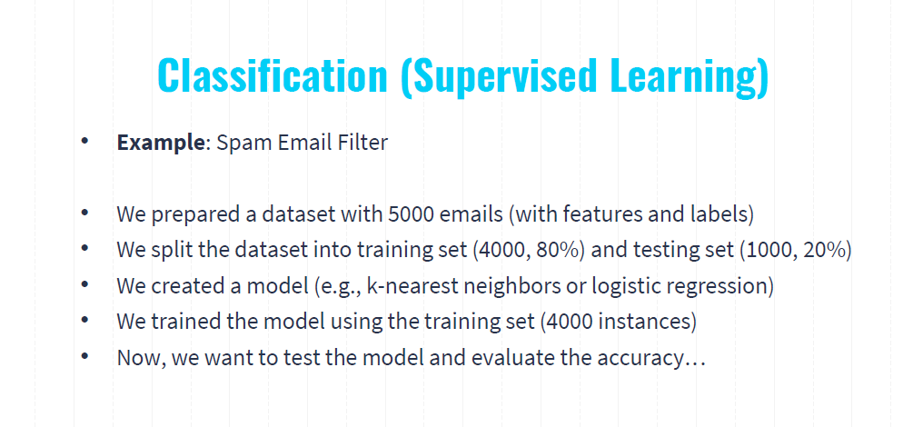
48

Slide 49
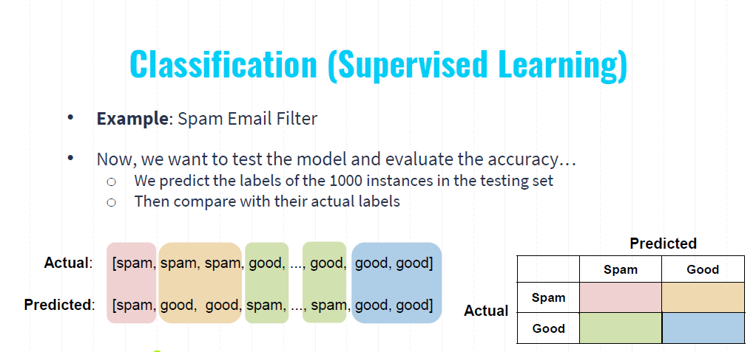
49
Notes:
The confusion matrix is a tool used to visualize the performance of a classification model. It helps us understand how many predictions were correct and where the model made mistakes.
Matrix Layout:
The rows represent the actual labels.
The columns represent the predicted labels.
Each cell in the matrix shows the count of instances for each combination of actual and predicted labels.
Now, we have two categories. So The matrix is divided into four quadrants
True Positives (TP): Predicted Spam and Actual Spam (top-left quadrant)
False Positives (FP): Predicted Spam but Actual Good (bottom-left quadrant)
False Negatives (FN): Predicted Good but Actual Spam (top-right quadrant)
True Negatives (TN): Predicted Good and Actual Good (bottom-right quadrant)

Slide 50
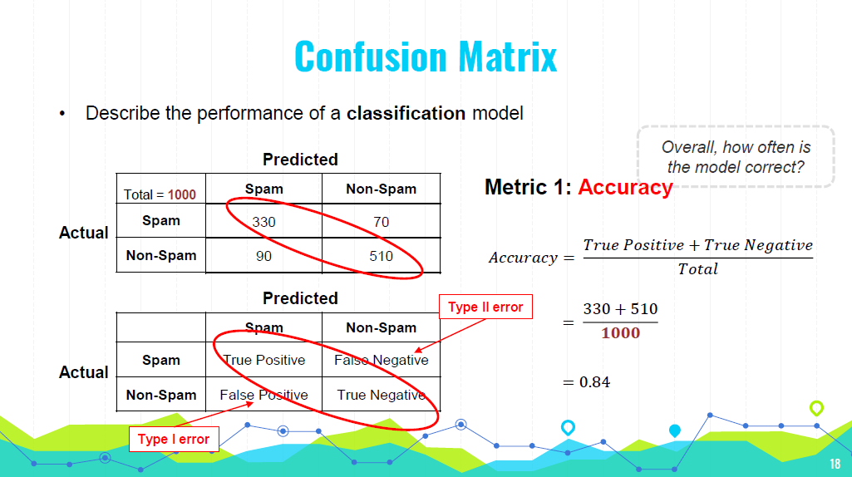
50
Notes:
a Type I error would mean marking a legitimate email as spam. This could result in missing important emails.
In medical testing, it could mean diagnosing a healthy person as having a disease, leading to unnecessary stress and treatment.
a Type II error would mean marking a spam email as legitimate.
In medical testing, it could mean failing to diagnose a person with a disease

Slide 51
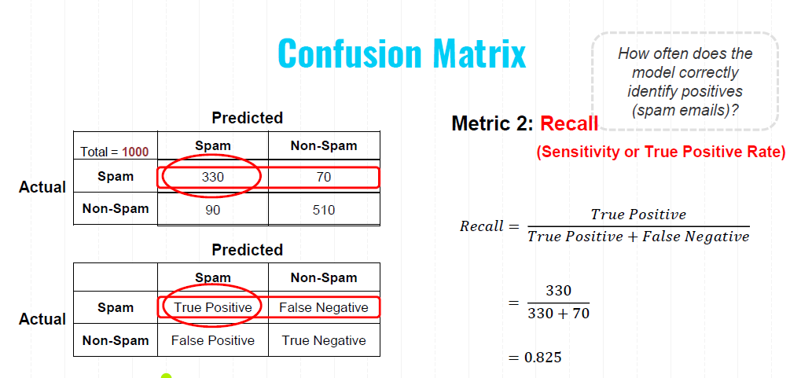
51
Notes:
Recall, also known as sensitivity or the true positive rate, measures how often the model correctly identifies positive instances (in this case, spam emails).

Slide 52
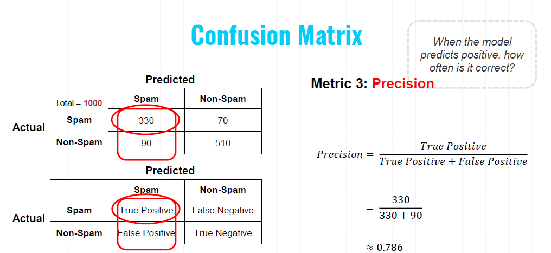
52
Notes:
Precision measures how often the model's positive predictions are correct. It focuses on the quality of the positive predictions made by the model.

Slide 53
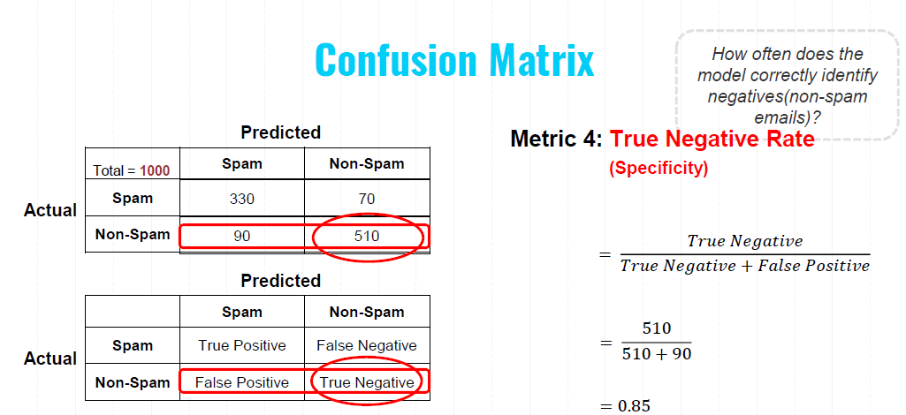
53

Slide 54
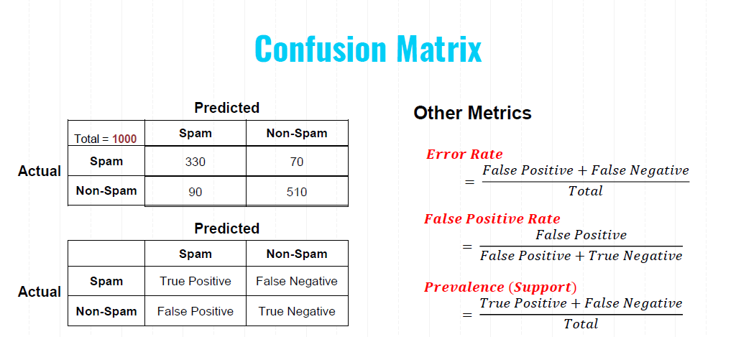

Notes:
Prevalence (or support) is the count of actual instances of a particular class in the dataset. It is a raw count of how many times each class appears in the actual labels.

Slide 55
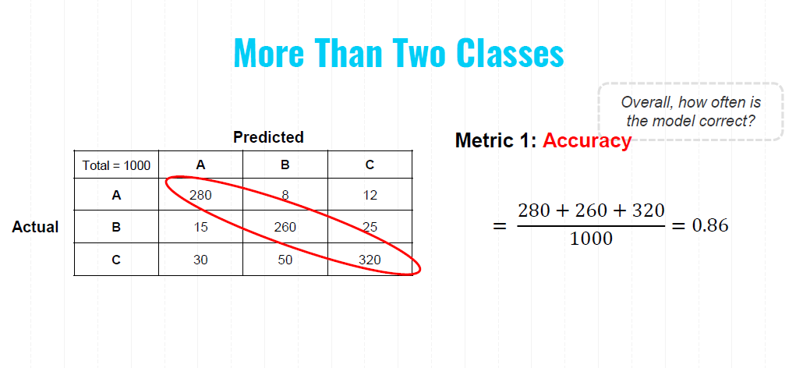

Slide 56
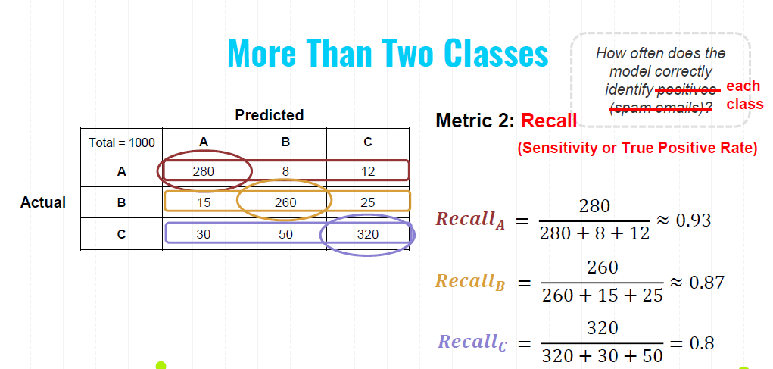

Slide 57
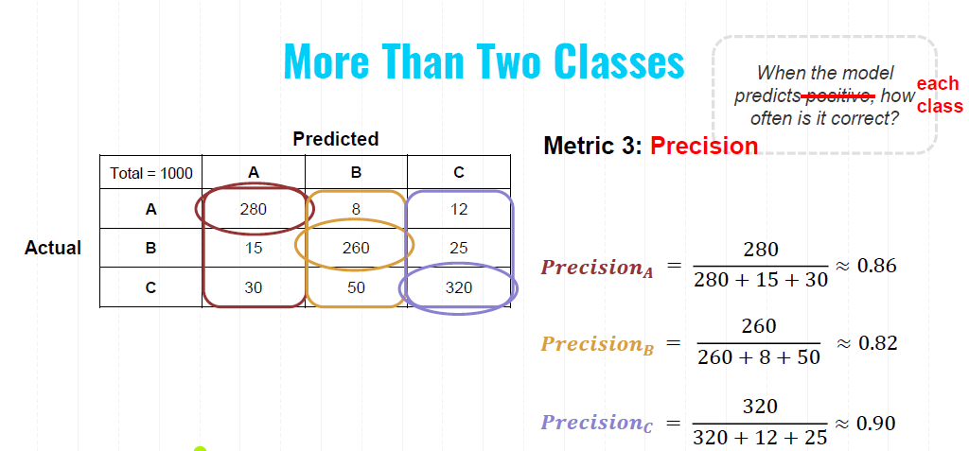
Notes:
Precision measures how often the model's predictions of each class is correct.

Slide 58
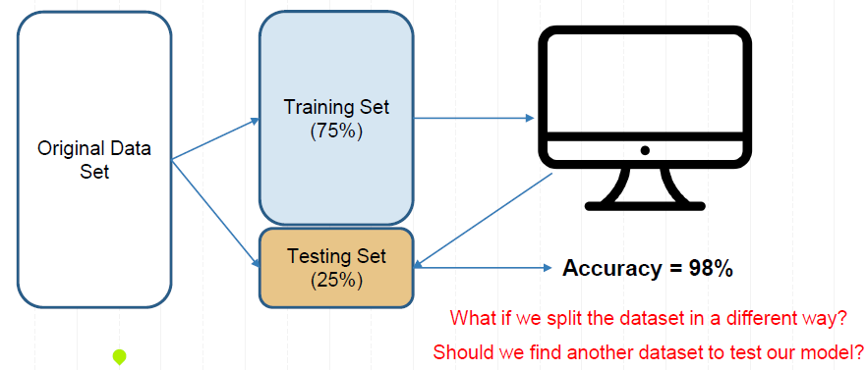
Cross-Validation
Is the Model Ready for Use?
Notes:
Selecting the Best Model: Cross-validation can be used to compare different algorithms and select the best-performing one.
Hyperparameter Tuning: Techniques like grid search or random search combined with cross-validation help in finding the optimal hyperparameters for the model.

Slide 59
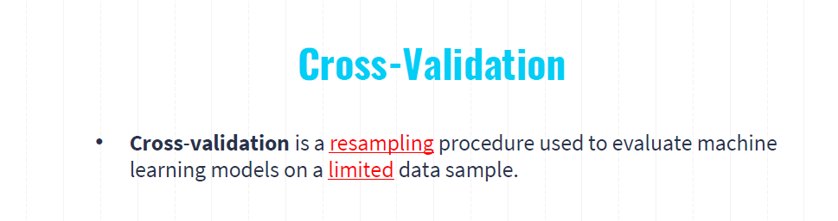
Splitting the Data: The dataset is split into K equal-sized (or nearly equal-sized) subsets.
Training and Validation: The model is trained K times, each time using K-1 folds for training and the remaining 1 fold for validation.
Rotation: The validation fold is rotated such that each of the K folds is used exactly once as the validation set.
Averaging the Results: The performance metric (e.g., accuracy, precision, recall) is averaged across all K trials to give an overall performance estimate.

Slide 60
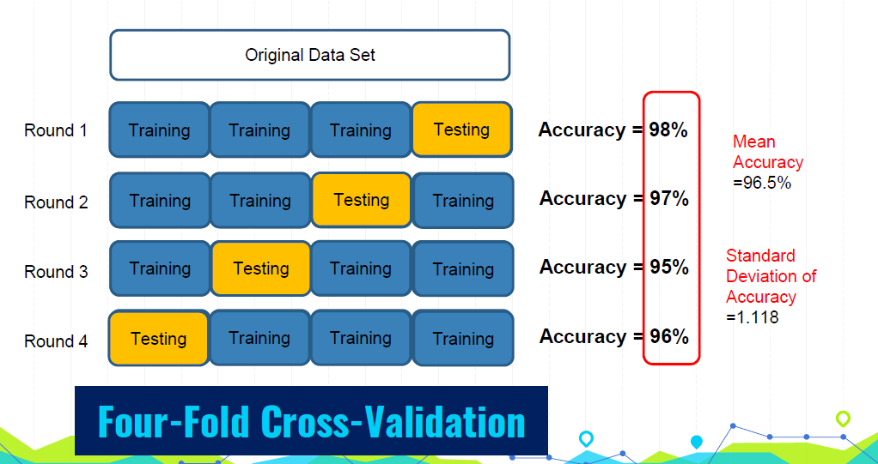
Notes:
Bias-Variance Tradeoff: A larger K results in lower bias but higher variance of the performance estimate. Conversely, a smaller K results in higher bias but lower variance.
Common Choices: Typically, K is set to 5 or 10, as these values have been shown to provide a good balance between computational efficiency and reliable performance estimates.

Slide 61
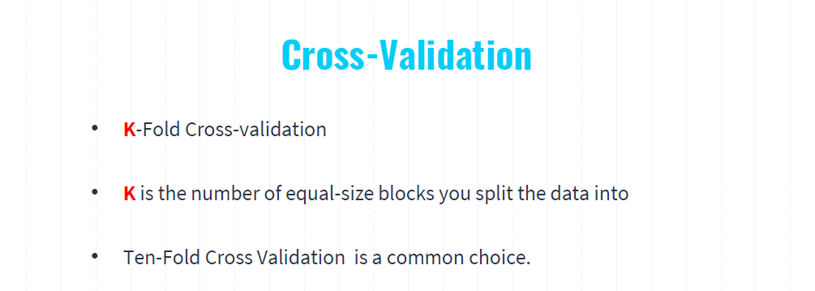

Slide 62
Machine Learning Steps
Gathering and loading data
Exploring data (e.g., pandas and visualization)
Transforming data (e.g., string to numeric)
Splitting data for training and testing
Choosing and creating a model
Training
Testing (evaluating accuracy)
Tuning the model (hyperparameters)
Making predictions on new data
62

Slide 63

Hyperparameter Tuning
Hyperparameter: model parameters specified in advance (before training)
What threshold to use?
What k to use?
?
𝒚
?
?
𝒙_{𝟏}
1 Nearest Neighbor
1
𝒙_{𝟏}
0.5
3 Nearest Neighbor
0.3
0
𝒙_{𝟏}
𝒙_{𝟏}
Logistic Regression
K-Nearest Neighbors

Slide 64
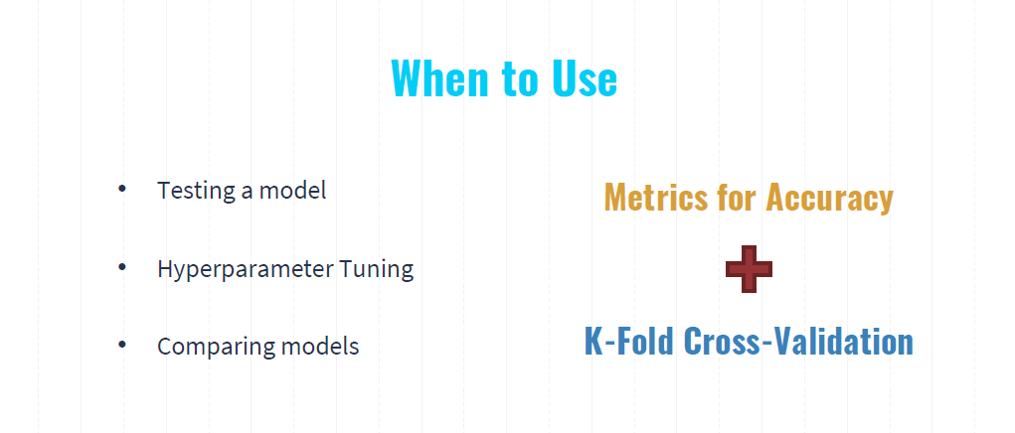
Notes:
Hyperparameter tuning refers to the process of optimizing the hyperparameters of a machine learning model to improve its performance. Hyperparameters are the parameters that are set before the learning process begins and are not learned from the data. They control the overall behavior and performance of the machine learning algorithm.

Slide 65
Machine Learning Steps
Gathering and loading data
Exploring data (e.g., pandas and visualization)
Transforming data (e.g., string to numeric)
Splitting data for training and testing
Choosing and creating a model
Training
Testing (evaluating accuracy)
Tuning the model (hyperparameters)
Making predictions on new data

Slide 66
5
Python and Machine Learning

Slide 67



Python and Machine Learning
Machine Learning
Deep Learning

Slide 68
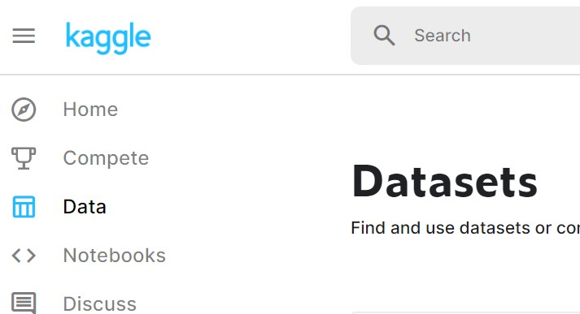
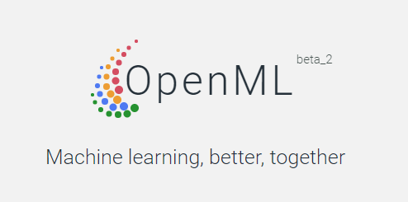
Machine Learning Datasets
https://www.kaggle.com/datasets
https://www.openml.org/

Slide 69
Q&A
Any questions?
You can find me at
wl563@cornell.edu
69

Slide 70
Machine Learning is Great For
Problems for which transitional solutions require a lot of fine-tuning or long lists of rules
Complex problems for which the traditional approach yields no good solution
Fluctuating environments
Getting insights about complex problems and large amounts of data
70

